Slide 1
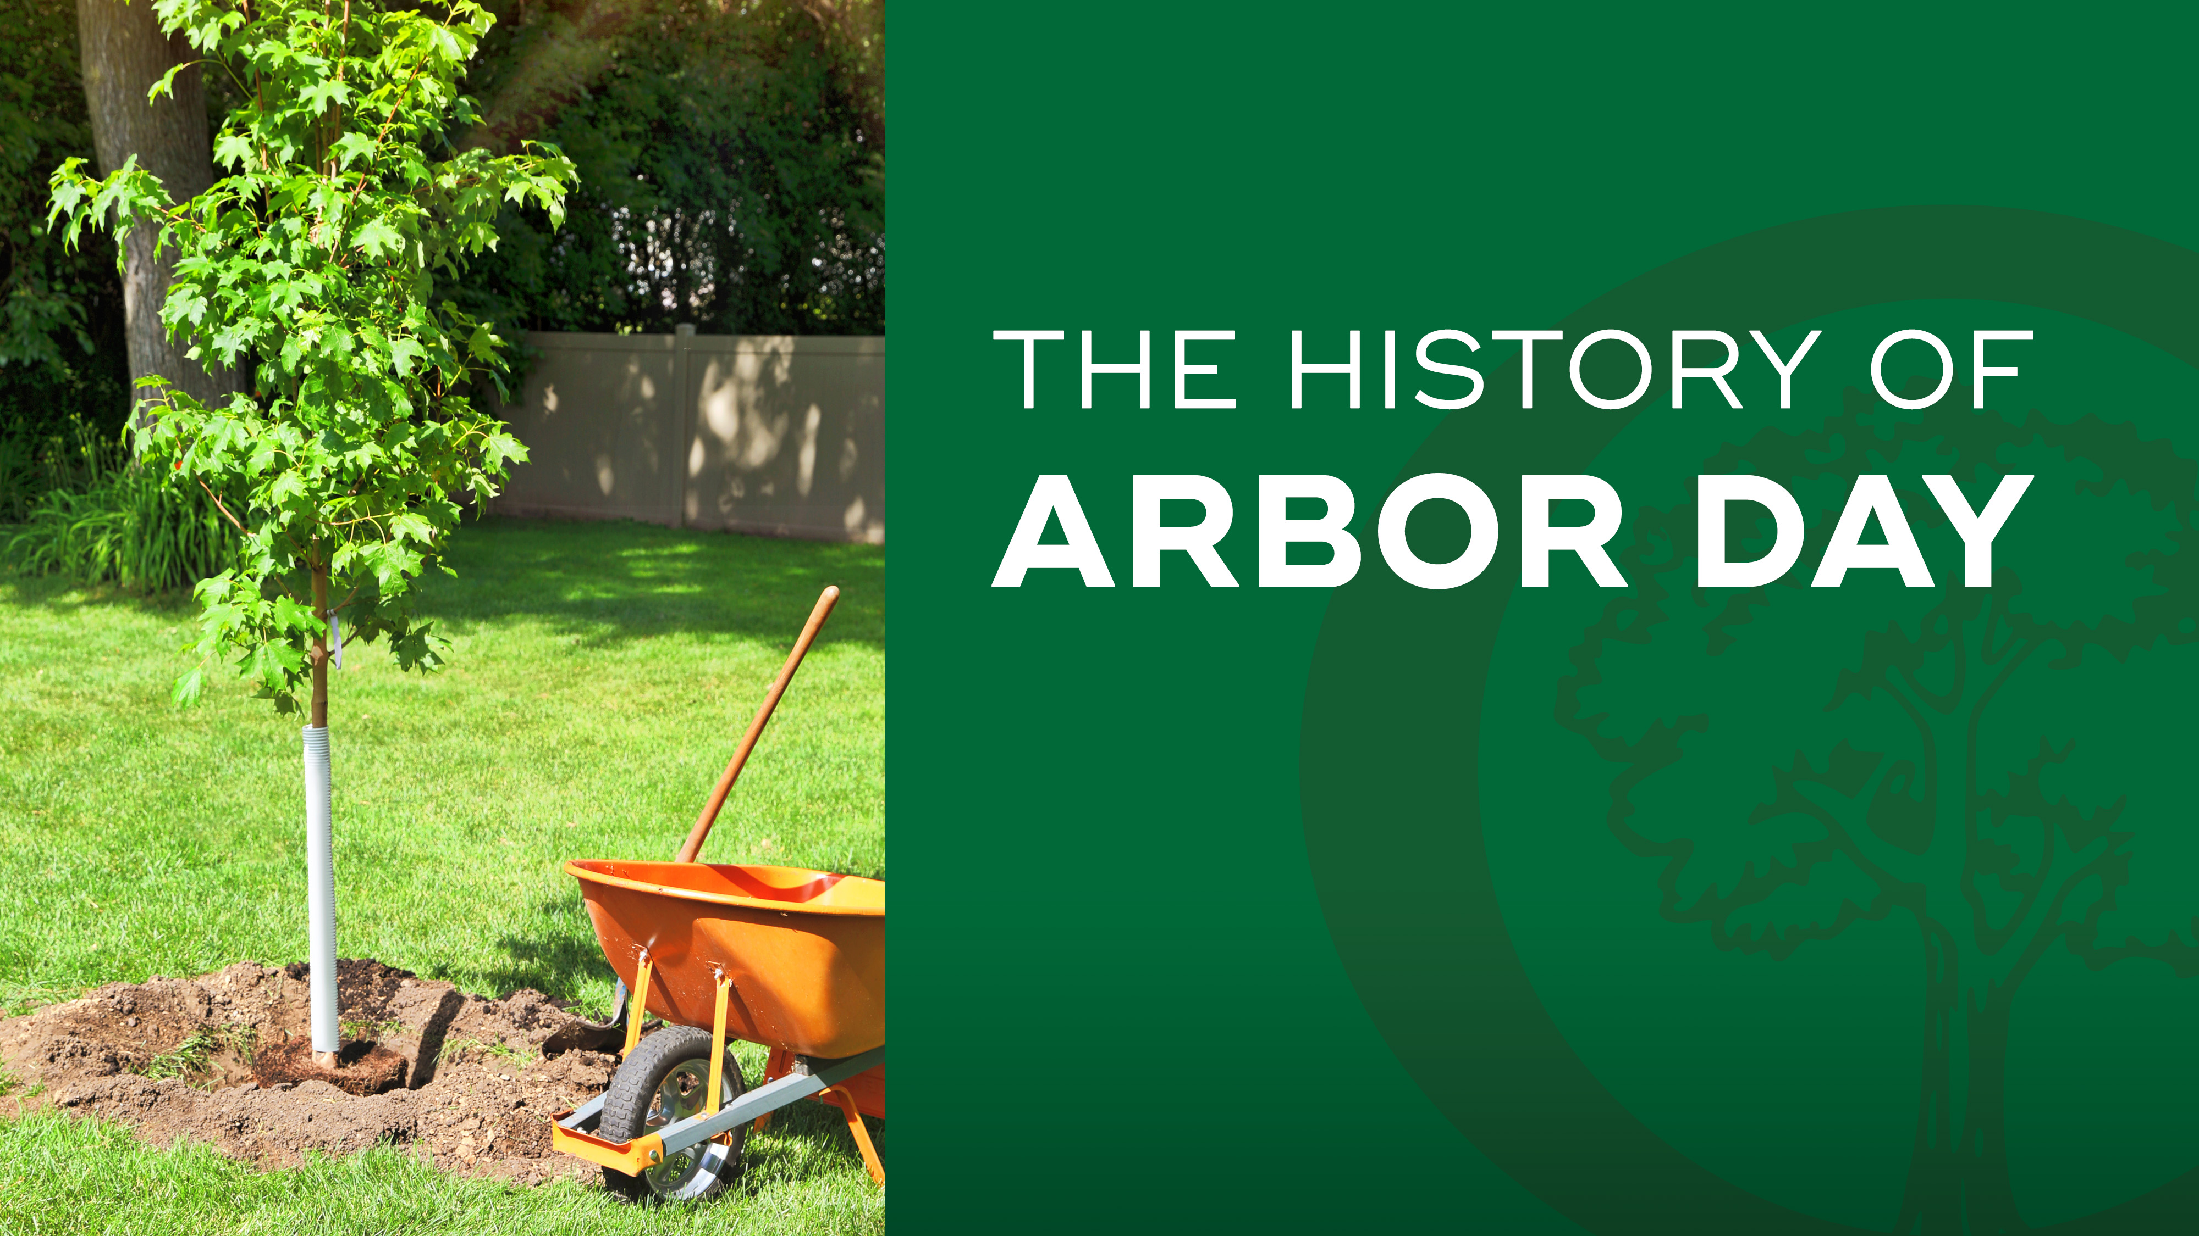

Notes:
How many of you have heard of Arbor Day before?
Who knows what Arbor Day is all about?
Good answers…
Today, we are going to dive into the history of this national holiday and why it is so important.

Slide 2

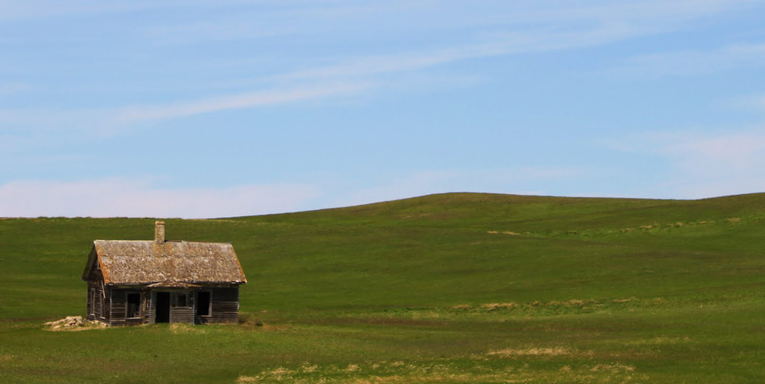

Notes:
The beginnings of Arbor Day can be traced all the way back to the mid-1800s. During this time, the government was offering free land to Americans through the Homestead Act. Many settlers moved out West to claim their land and build homes on the open prairie.
One of the states these settlers flocked to was Nebraska, located in the middle of the country.

Slide 3
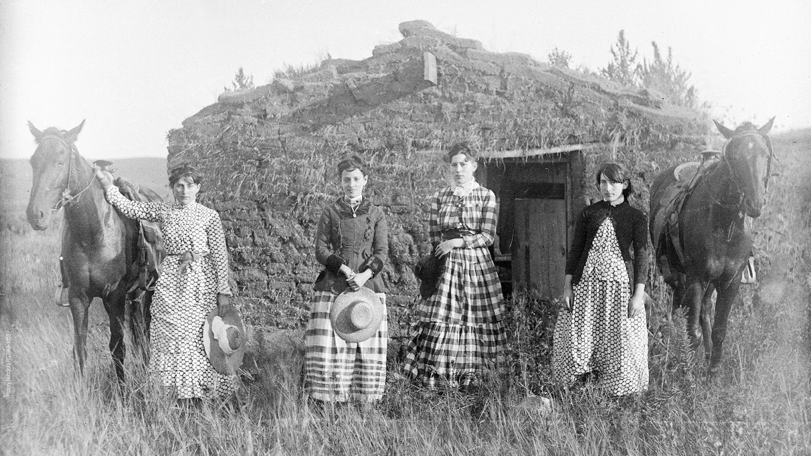
Notes:
Life on the prairie wasn’t nearly as comfortable as it is today. One of the biggest reasons was a lack of trees. Without wood to build homes, many settlers lived in sod houses. They were exposed to the beating sun in the summer and cold winds in the winter. And they couldn’t chop wood to build fires and keep themselves warm.

Slide 4
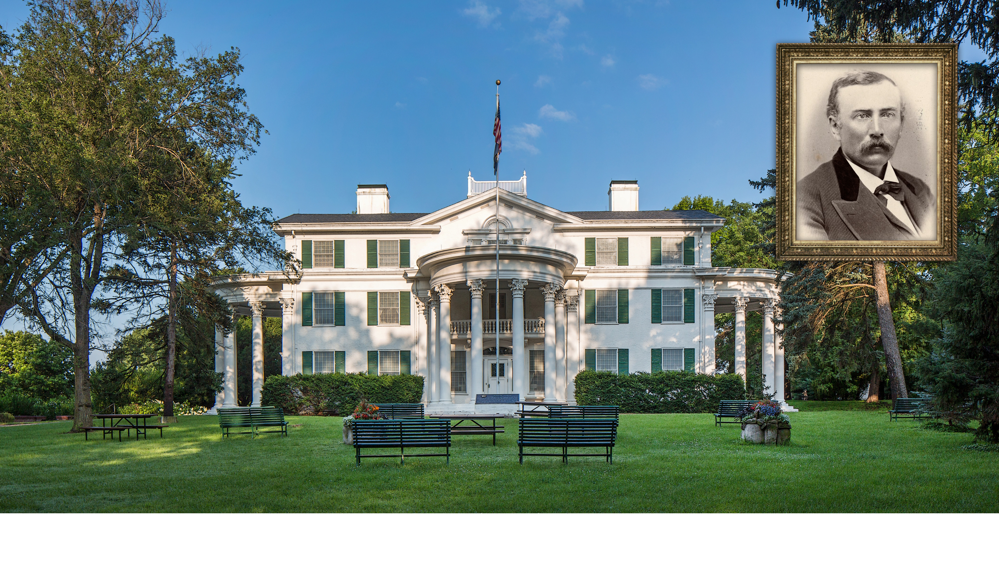
Notes:
J. Sterling Morton was one of these early settlers. He recognized the dire need for trees in Nebraska and wanted to find a way to encourage everyone in the state to plant them. Pictured is the Morton family home, now known as Arbor Lodge.

Slide 5
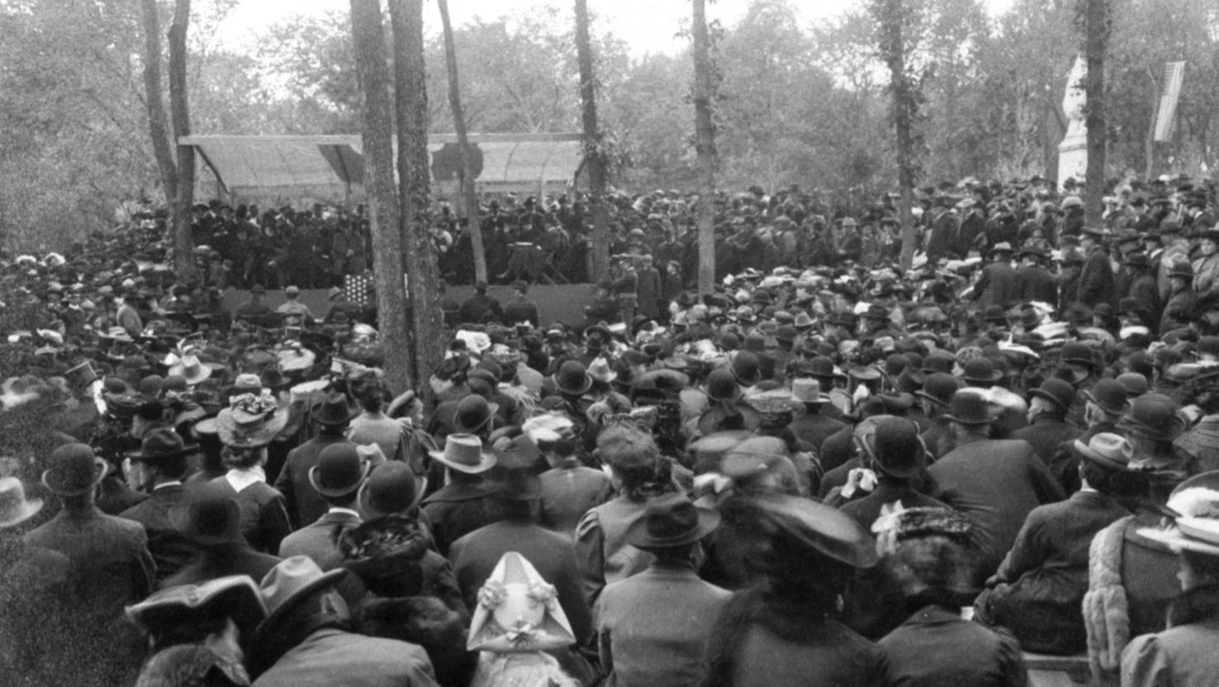
Notes:
In 1872, Morton proposed a new tree planting holiday to the state legislature. It was called Arbor Day.
The first Arbor Day celebration was held in Nebraska on April 10, 1872. Prizes were offered to the individuals and counties who planted the most trees. On that day, an estimated 1 million trees were planted across the state.

Slide 6
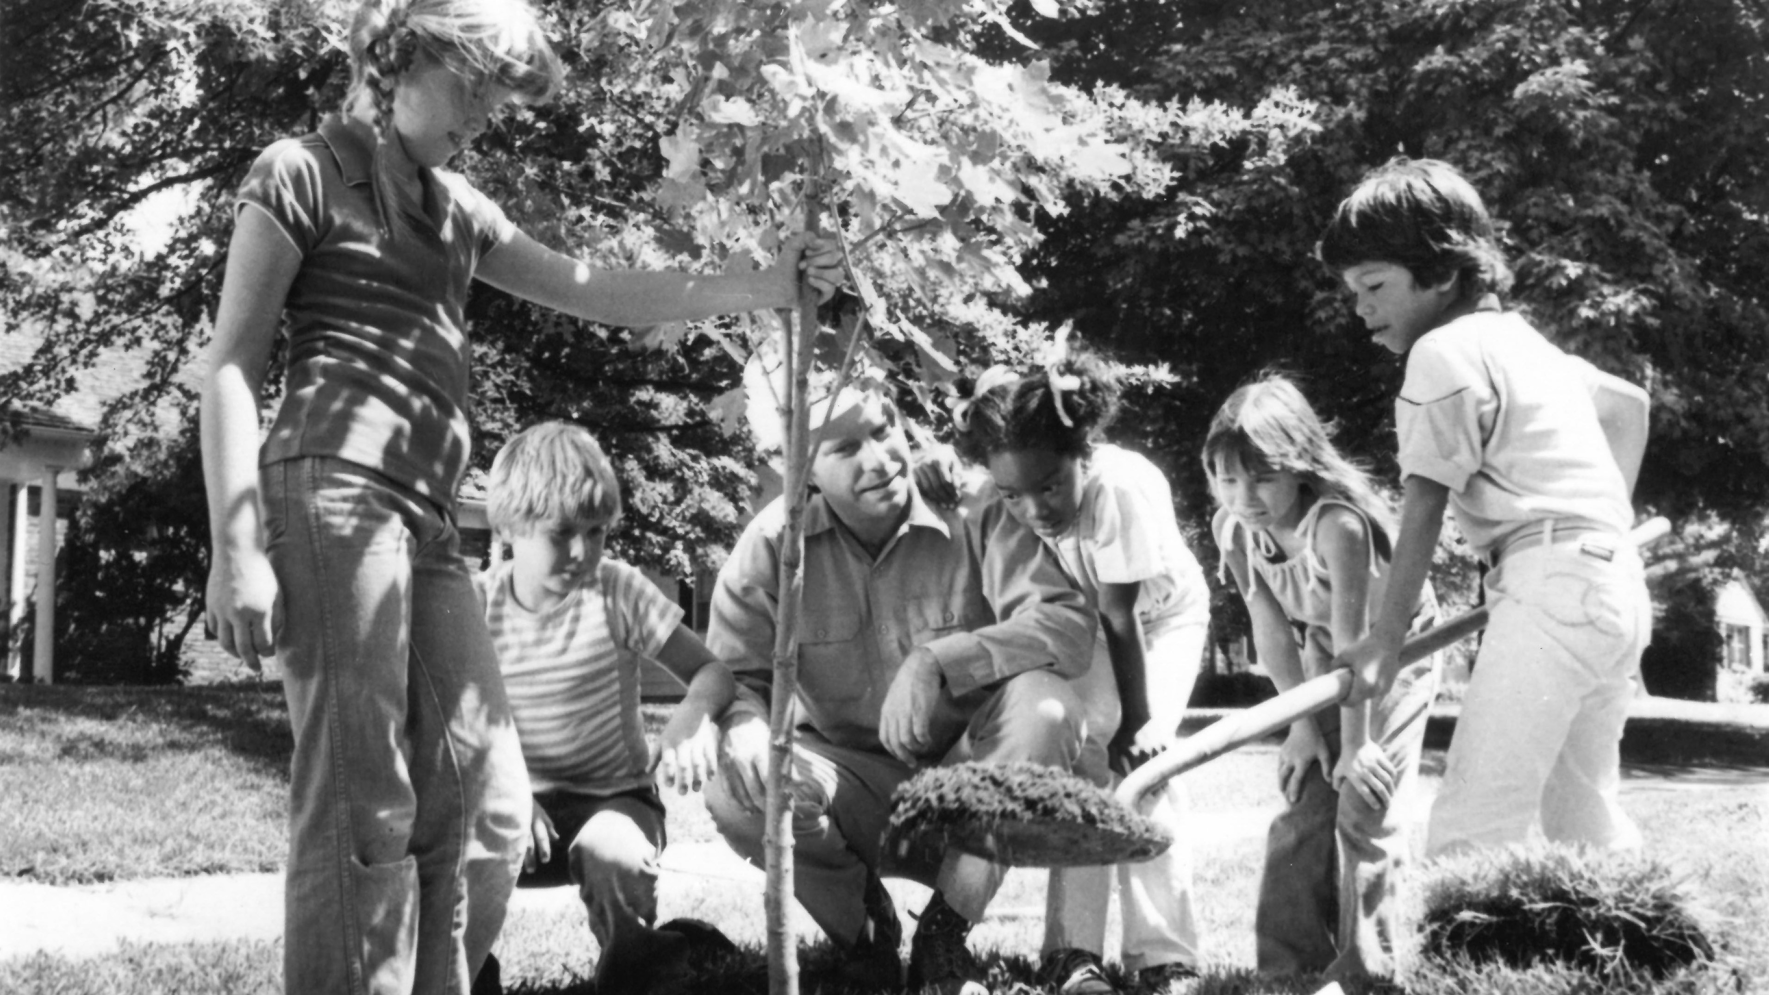
Notes:
Soon, other states heard about this success and wanted to join in. One by one, they began adopting their own Arbor Day celebrations, until the idea eventually spread to all 50 states.
Today, Arbor Day is not only celebrated nationwide. It is also celebrated by dozens of countries around the world.

Slide 7
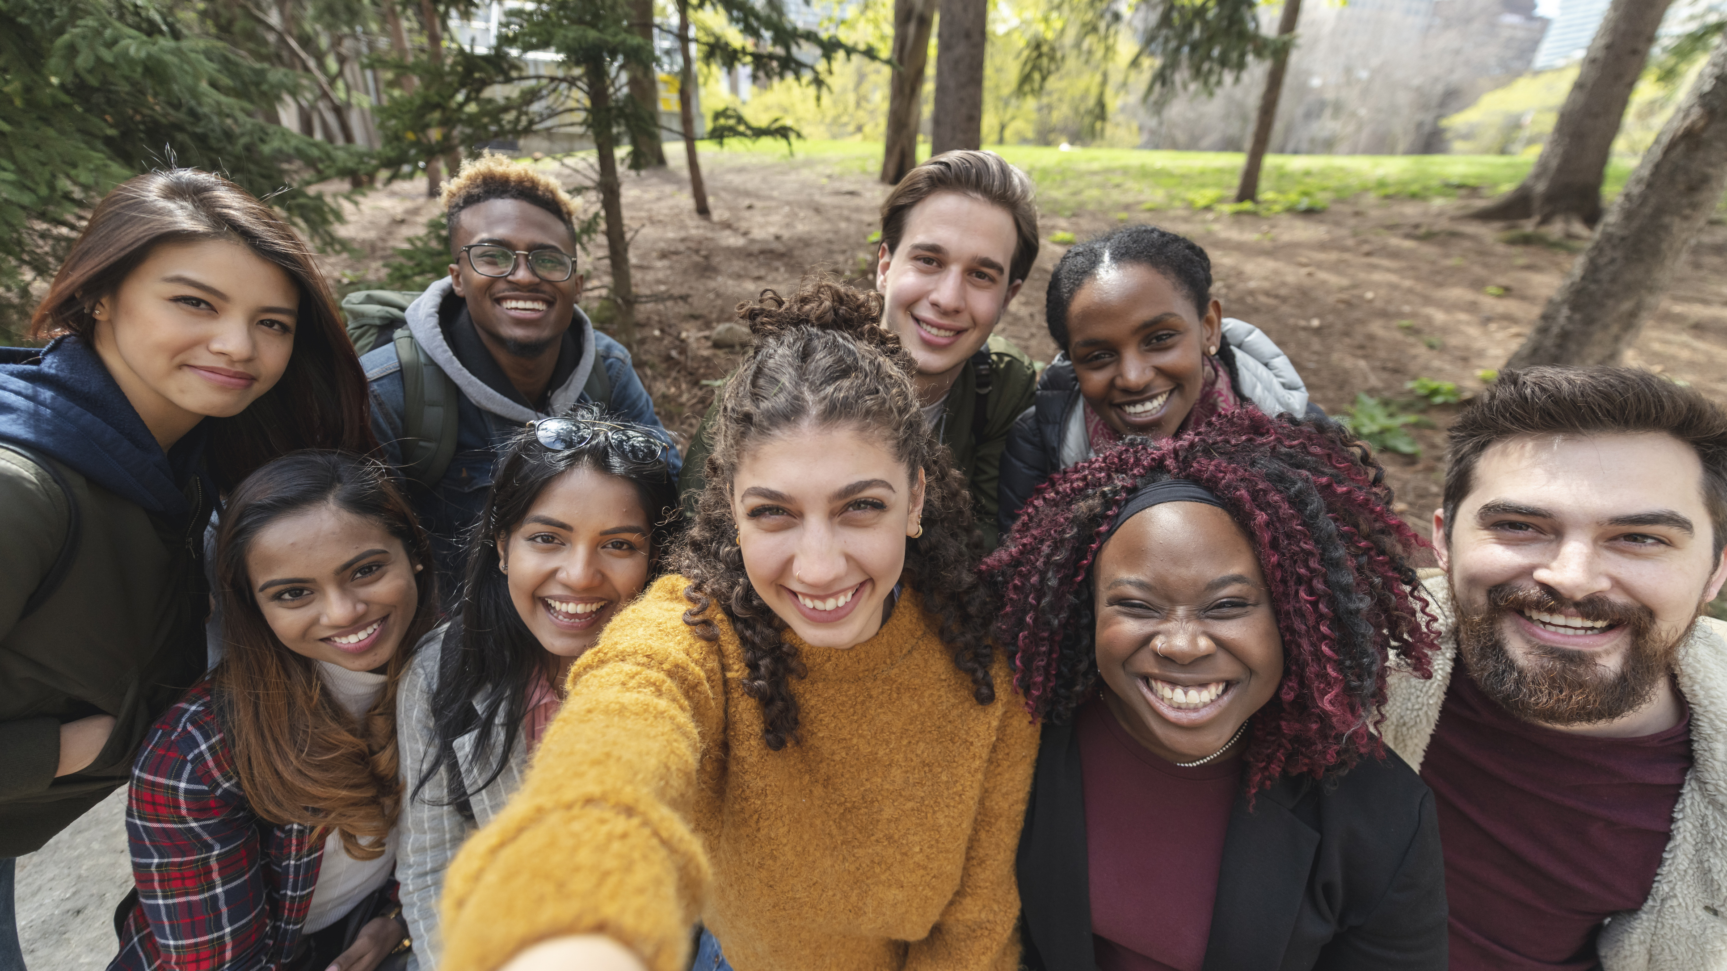
Notes:
So, why are people so passionate about this holiday? And why are trees so important?
We’ve already covered the basics. They provide shade and shelter to us every day.
But there are many more reasons you might not realize, like…

Slide 8
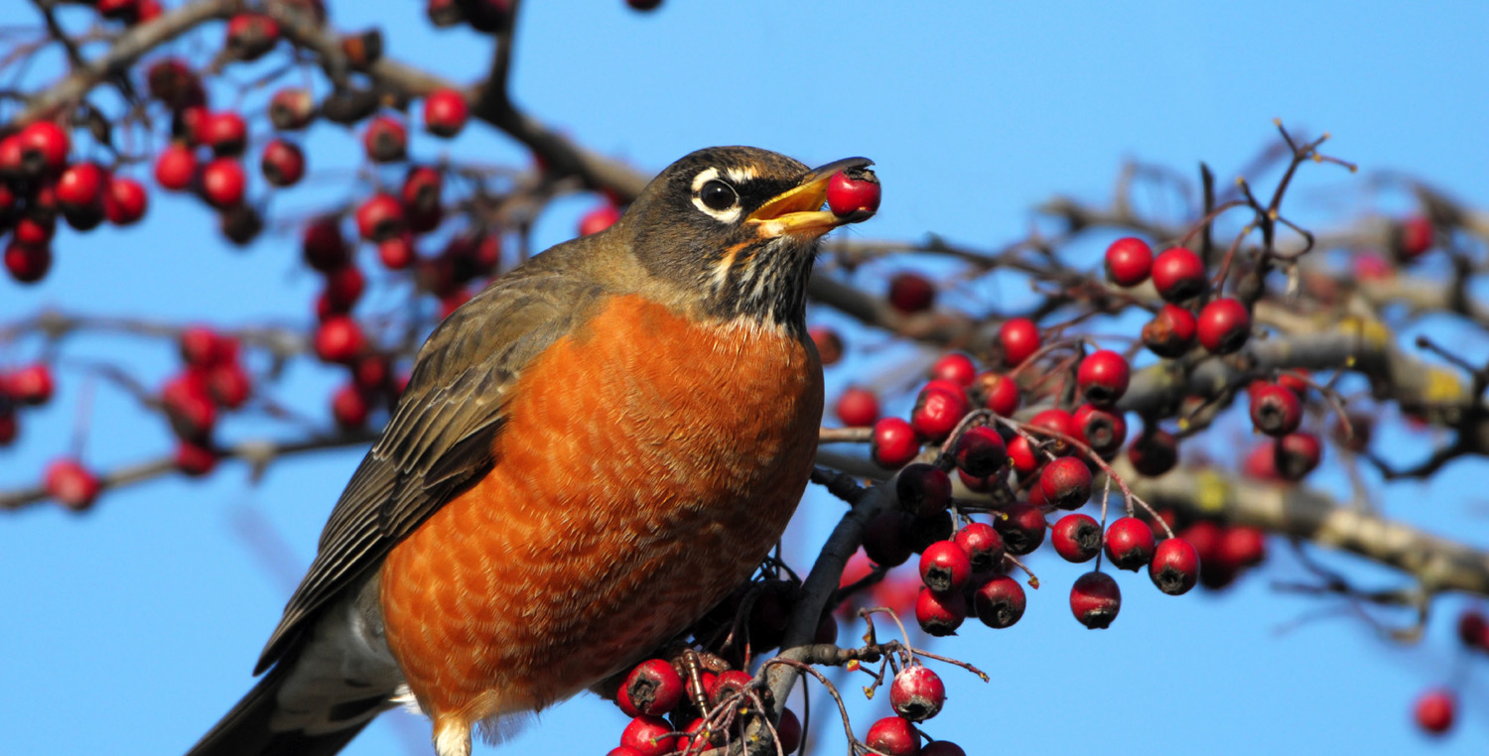
Notes:
They provide shelter and food for animals. Even fish rely on trees to filter pollutants out of rivers and lakes!

Slide 9
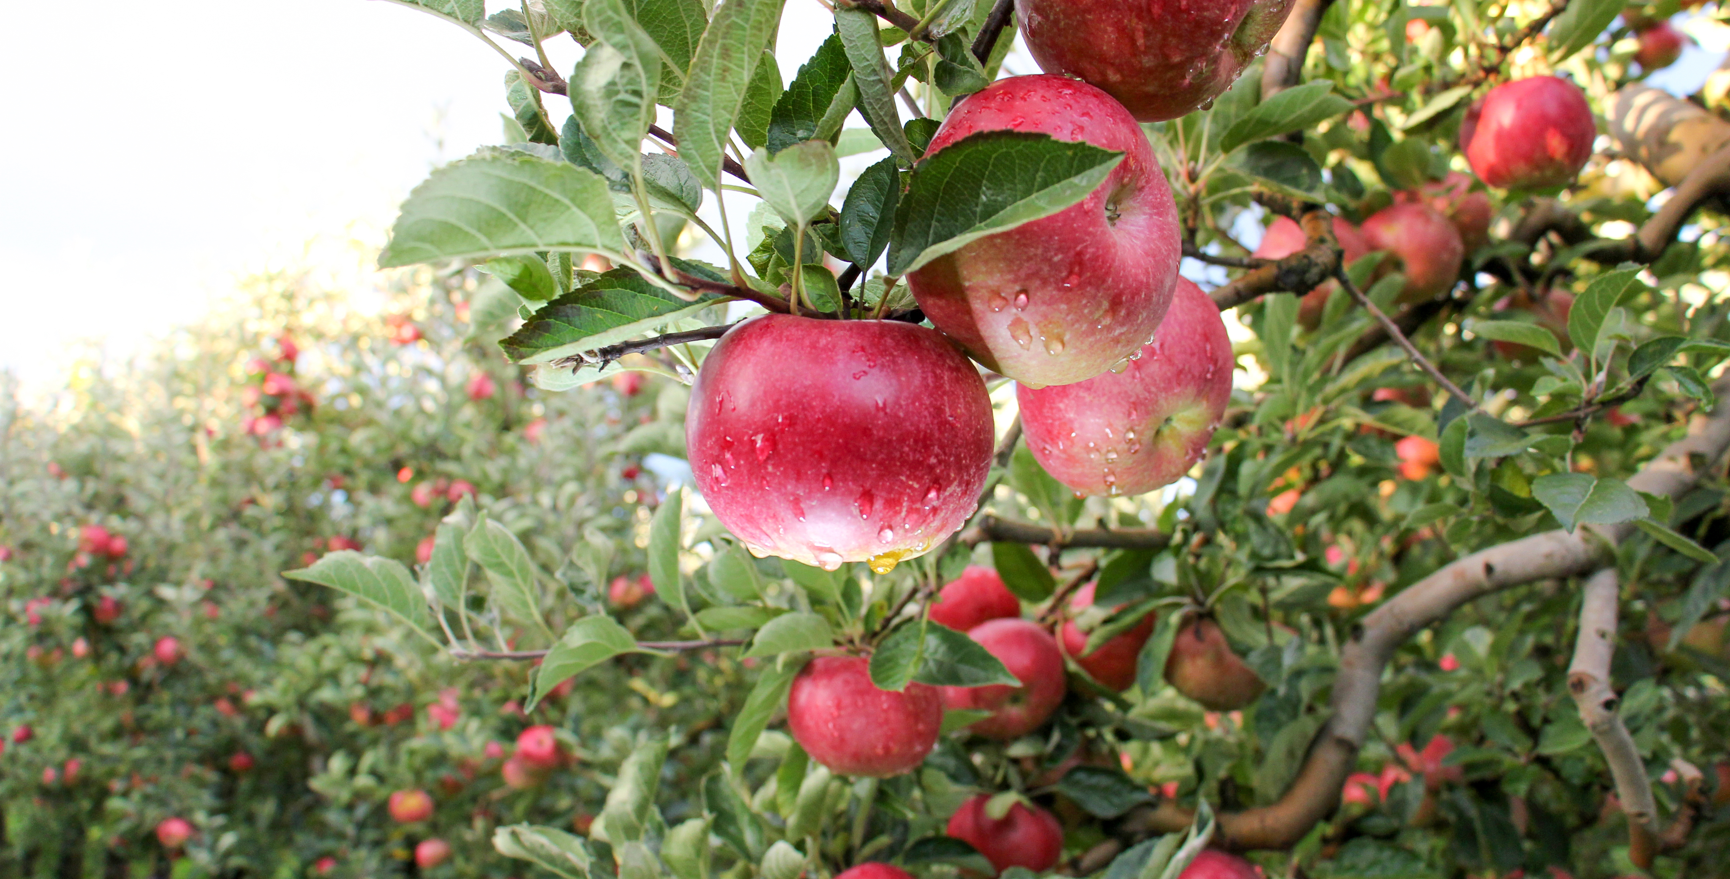
Notes:
They give us delicious foods like nuts, berries, and fruit.

Slide 10
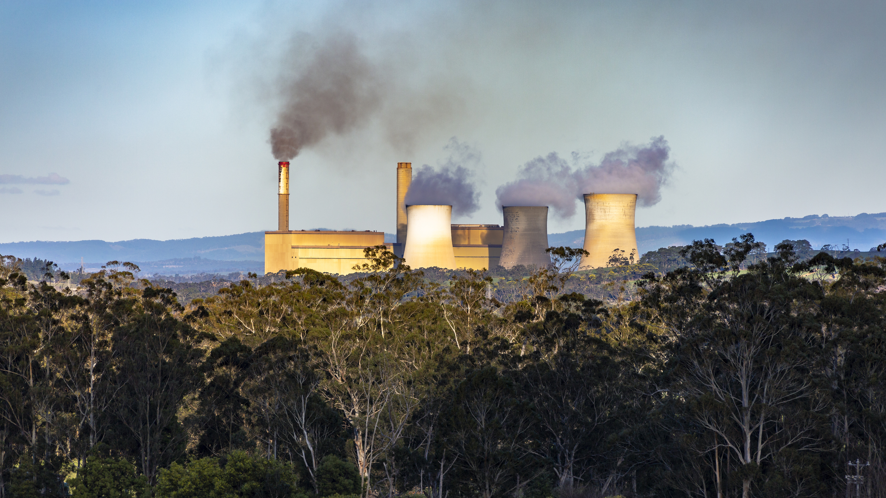
Notes:
They remove carbon from the air. Carbon emissions are the polluted air that comes from manufacturing facilities, cars and other pollution causing human behavior. Excess carbon is harmful to our atmosphere and causes temperatures in our communities to rise.

Slide 11

Notes:
They help us breathe! Trees produce oxygen, which we need to survive.

Slide 12

Notes:
And finally, they make our communities more beautiful and relaxing. Without trees, our neighborhoods would be much emptier. They would also be louder, since trees provide a buffer against noise!

Slide 13
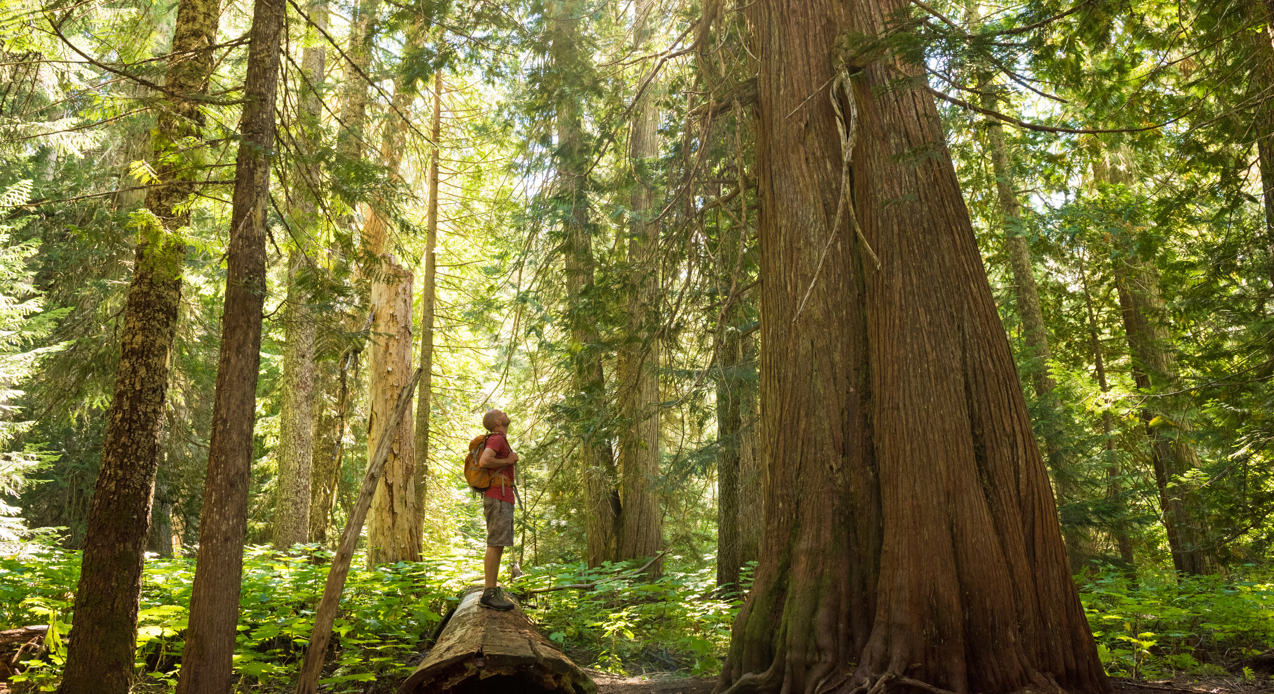
Notes:
There are lots of record-breaking trees out there. Let’s see if you know any of them!

Slide 14
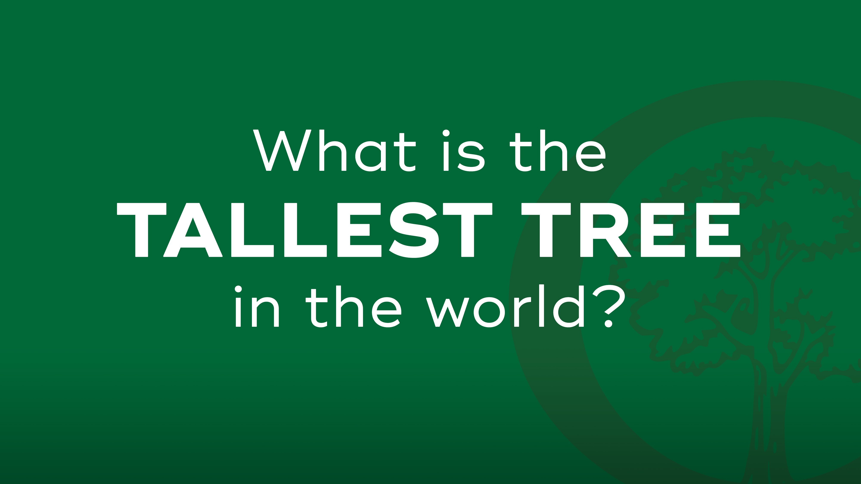

Slide 15
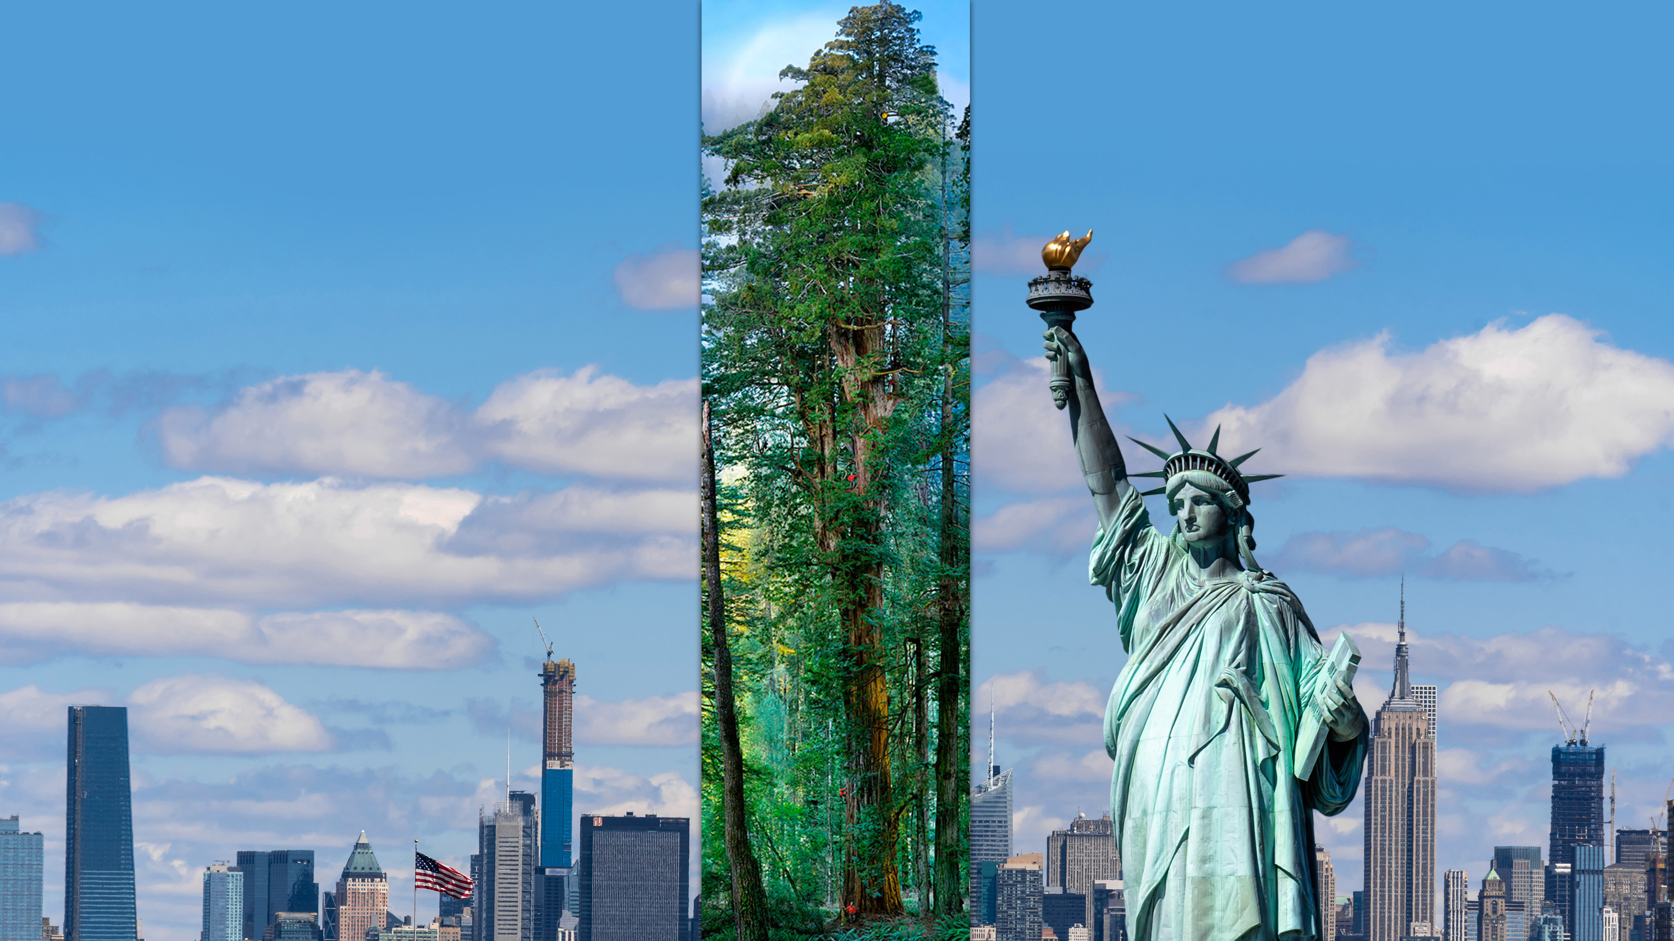
Notes:
It’s a California redwood tree called “Hyperion.” This tree is 380 feet tall, which is taller than the Statue of Liberty.

Slide 16
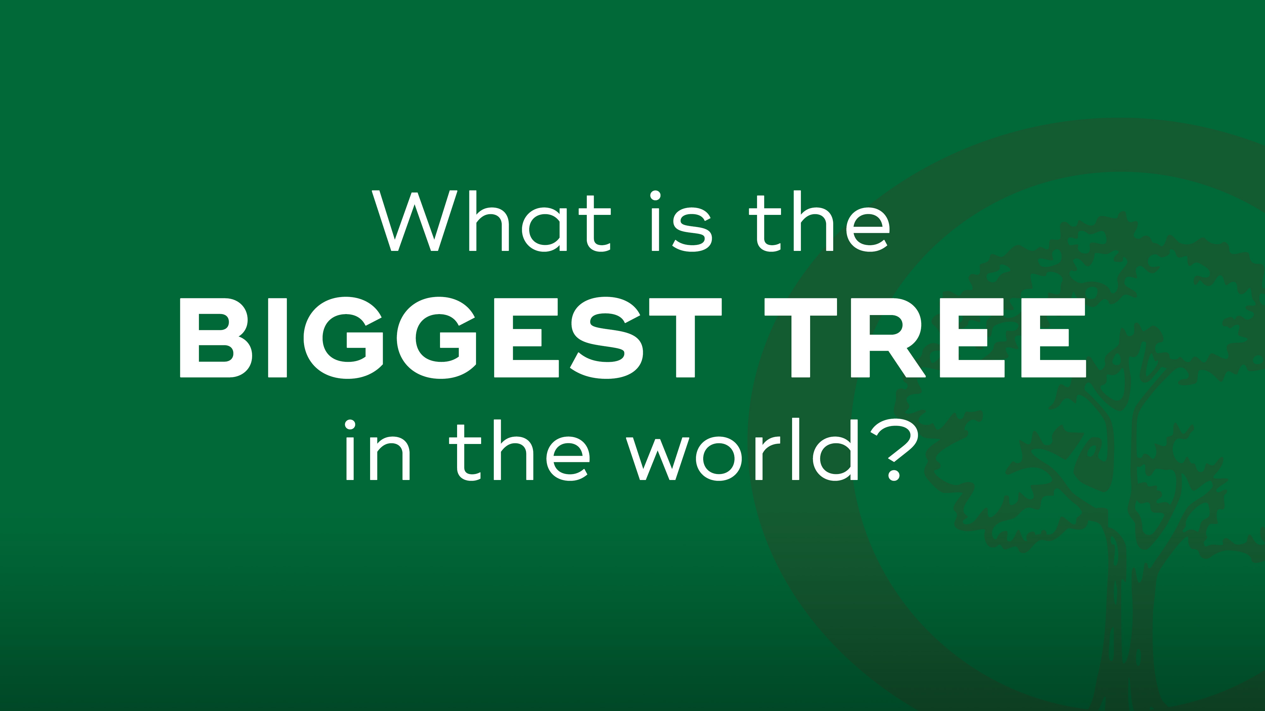

Slide 17
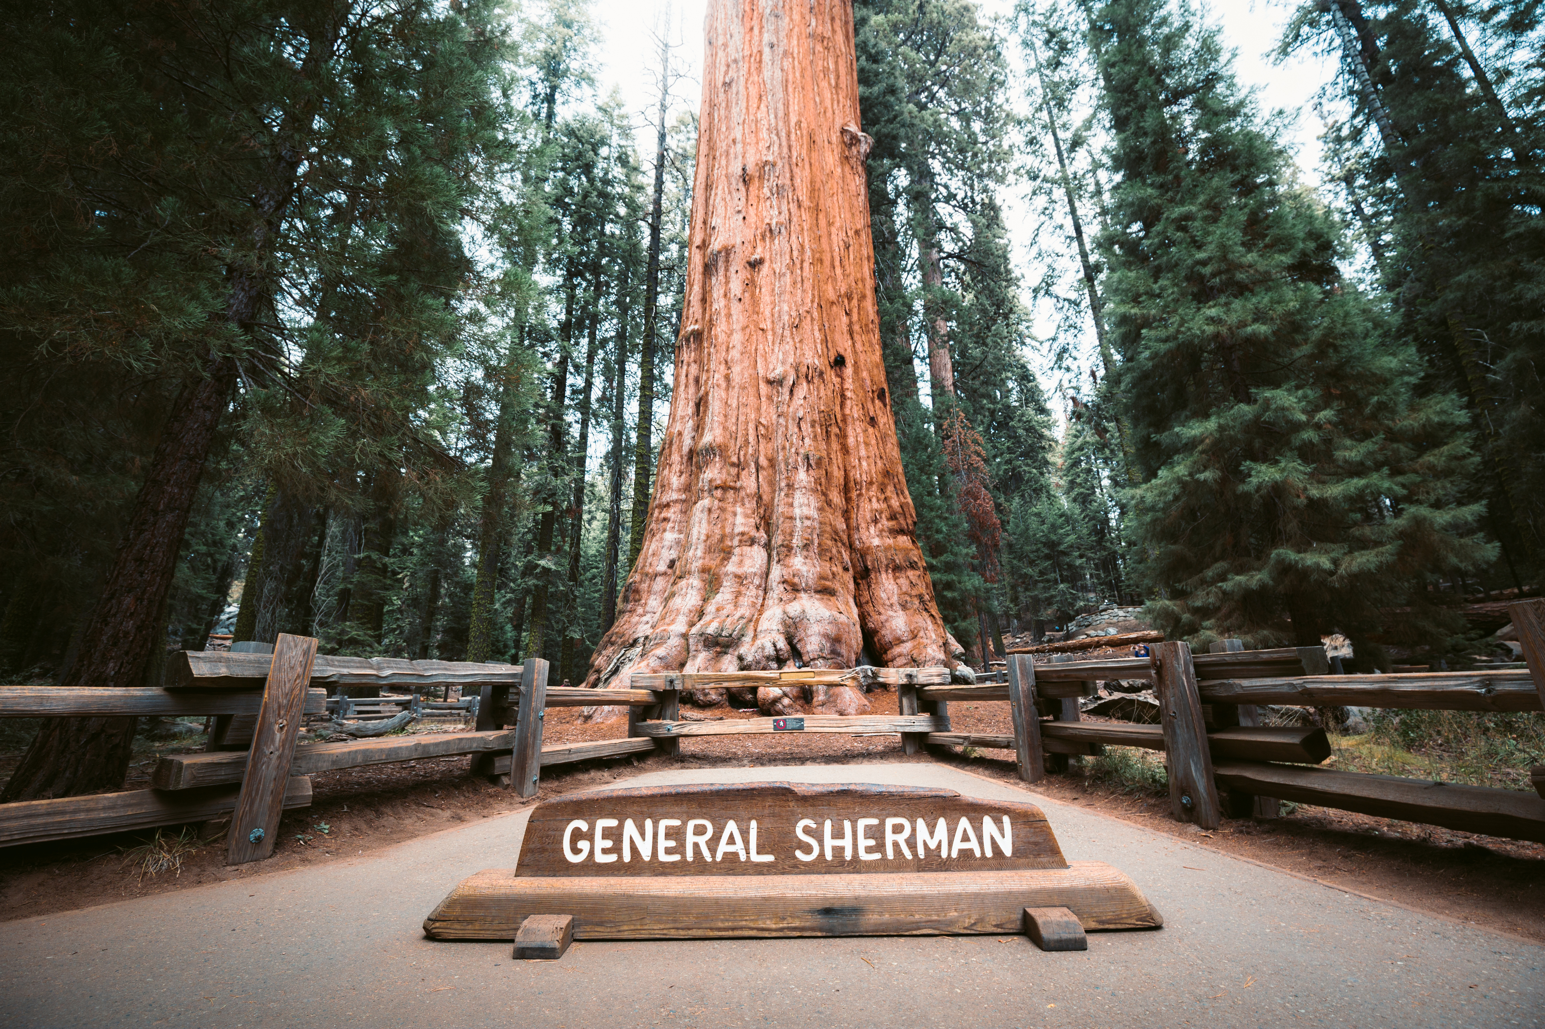
Notes:
General Sherman, a giant redwood in California, is the biggest tree in the world. Its largest branch has a diameter of almost 7 feet!

Slide 18
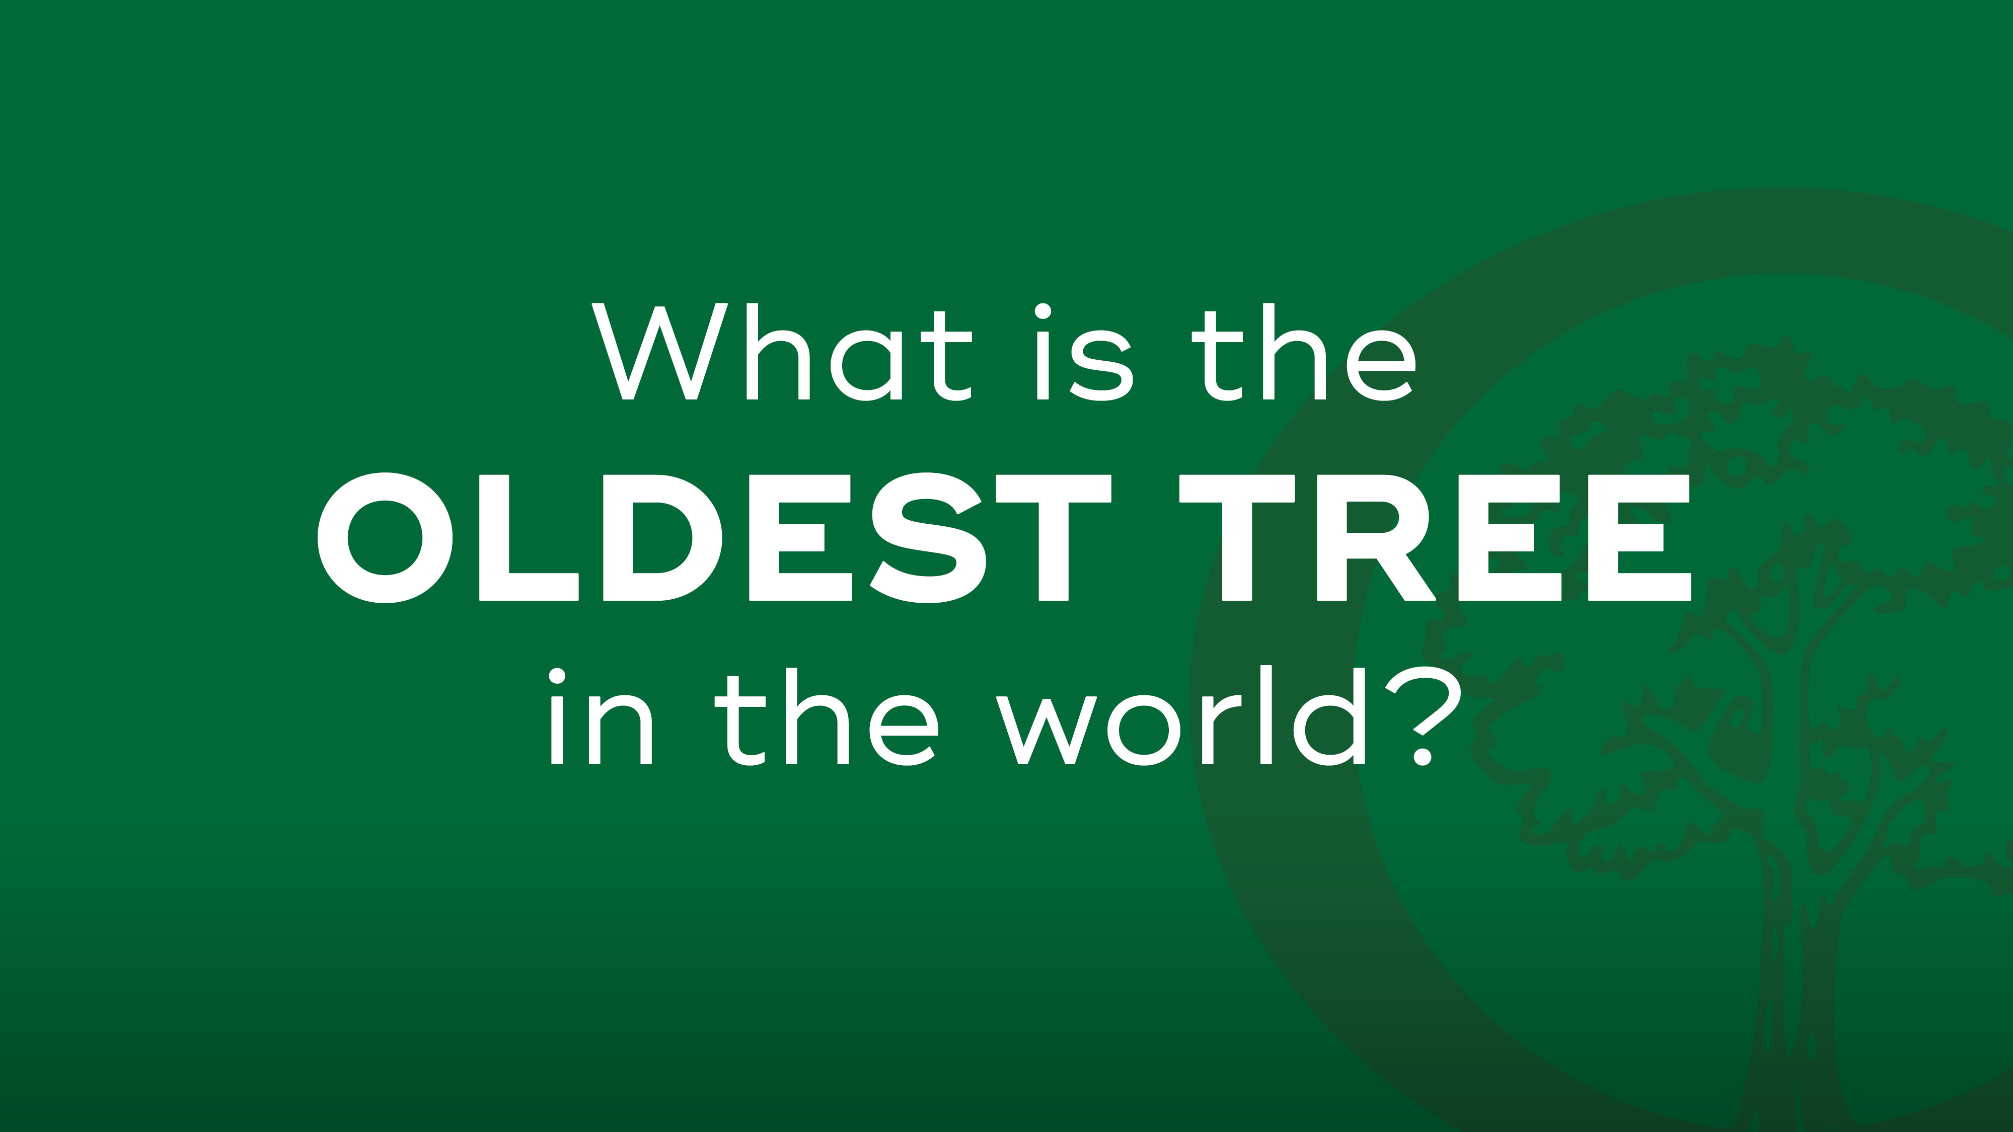

Slide 19
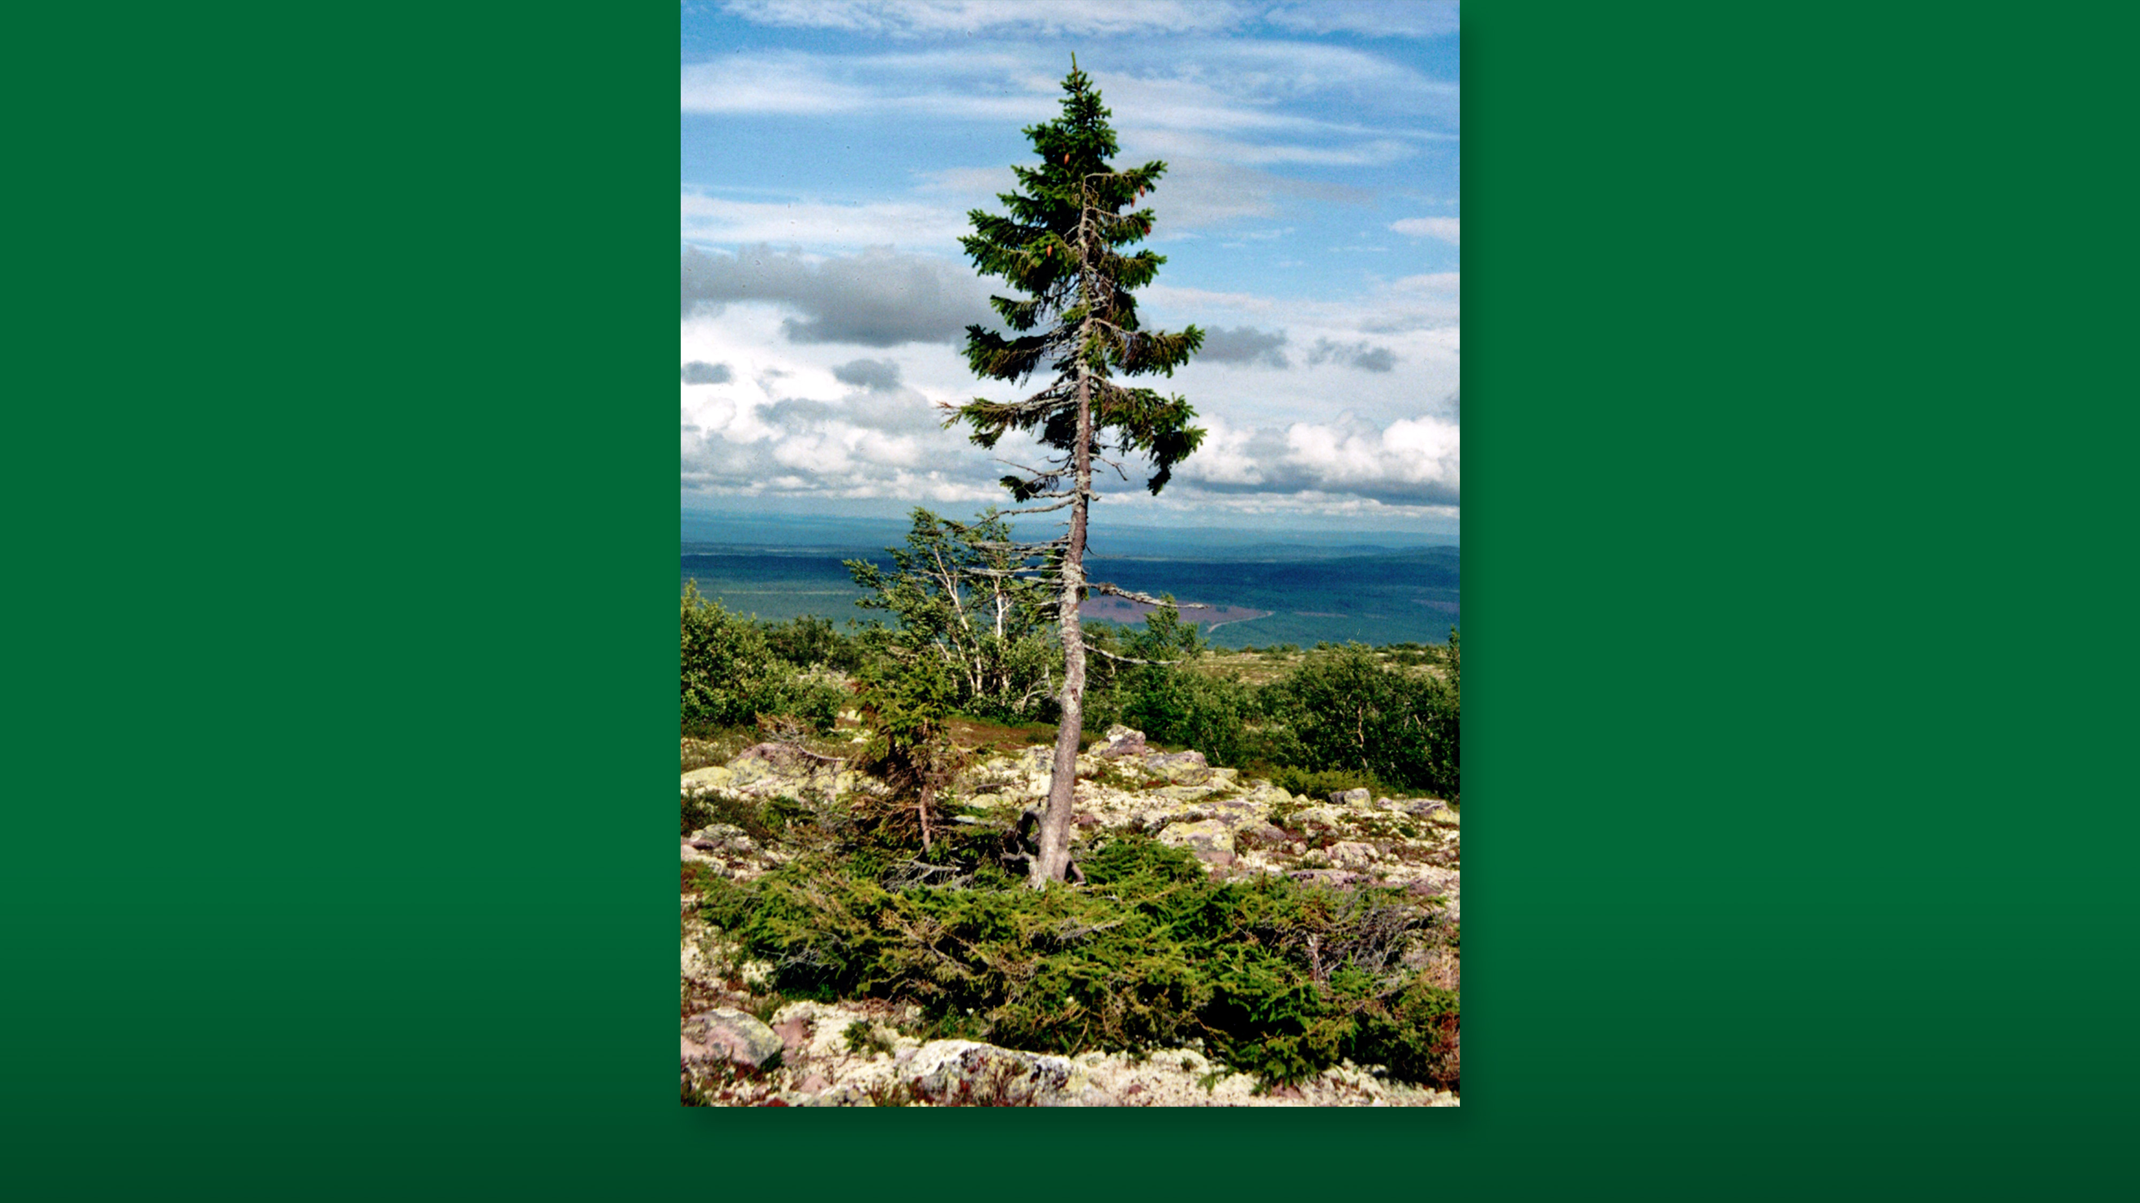
Notes:
A bristlecone pine tree from California called “Methuselah.” It’s 4,800 years old.

Slide 20
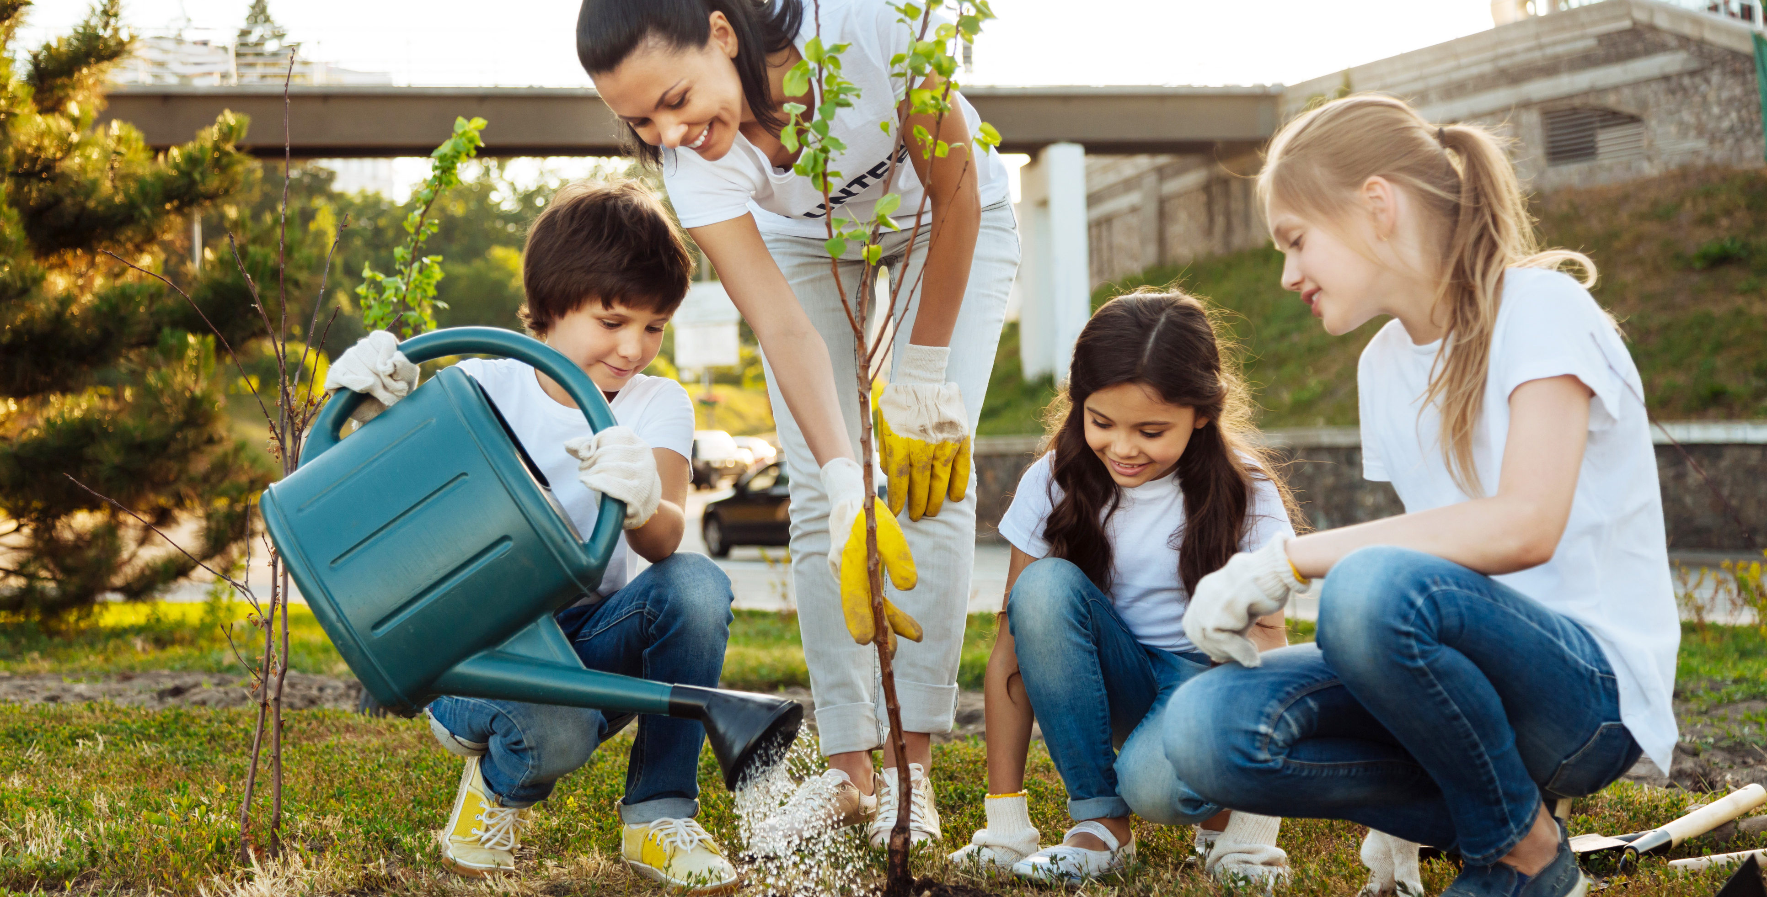
Notes:
As you can see, trees are pretty special. That’s why it’s so important to celebrate Arbor Day – and celebrate trees all year round!

